Slide 1
Academic Listening
Unit 3

Slide 2
Academic Listening

Slide 3
Lessons
Note-taking techniques & Lecture internal structure
Predicting & Monitoring
Building background knowledge & Inferencing
Clarifying & Responding
Evaluating & Combining the skills

Slide 4
Videos
Renewable energy
Solar power
Wind energy
Biomass
Hydroelectric energy

Slide 5
Weekly classes
Theory
Read about strategies provided in Word document
Check with answers in PowerPoint presentations
B. Practice
Watch the video. Listen and take notes.
Check with answer key uploaded in our Virtual Classroom

Slide 6
Tasks
Auto correction tasks
Quiz (Virtual Classroom)
Assignment

Slide 7
Exam
Watch video on Hydro power
Take notes using telegraphic language and appropriate format
Type or handwrite your notes
Upload in PDF format

Slide 8
Outline Layout
Organizing your notes in main ideas
Separating main ideas from supporting ideas
Listing supporting ideas with corresponding details and nuances or examples
Using numbers and letters to show hierarchy

Slide 9
Standard Outline Format
Main Ideas: Roman Numerals
Supporting Ideas: Arabic Numerals
Details: Capital Letters
Nuances / Examples: Small Letters
* From left to right
(you may use a different order as long as it is organized in hierarchical levels)

Slide 10
Example
I. 1st main idea
1. 1st supporting idea
A. 1st detail
a. 1st nuance / example
b. 2nd nuance / example
II. 2nd main idea
1. 1st supporting idea
A. 1st detail
B. 2nd detail
2. 2nd supporting idea
etc.

Slide 11
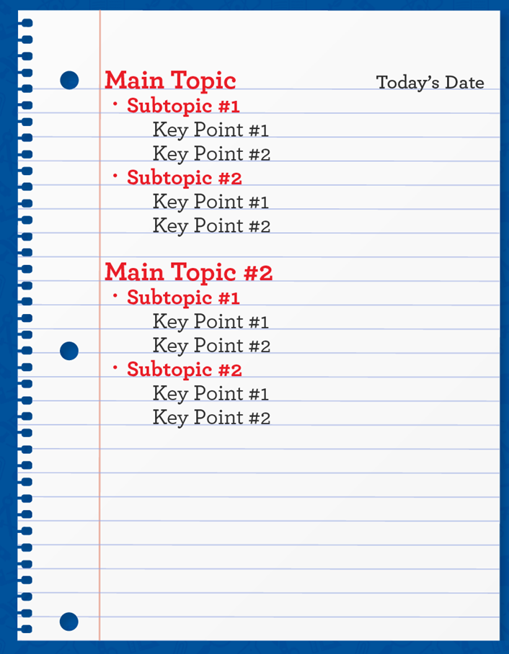
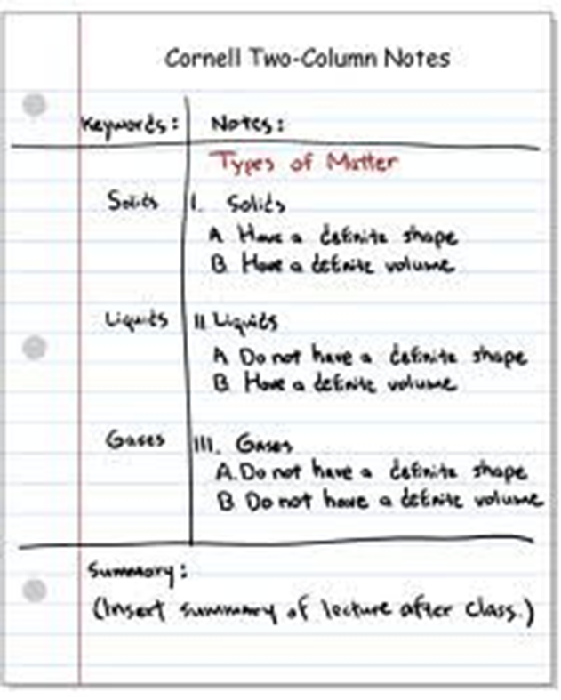
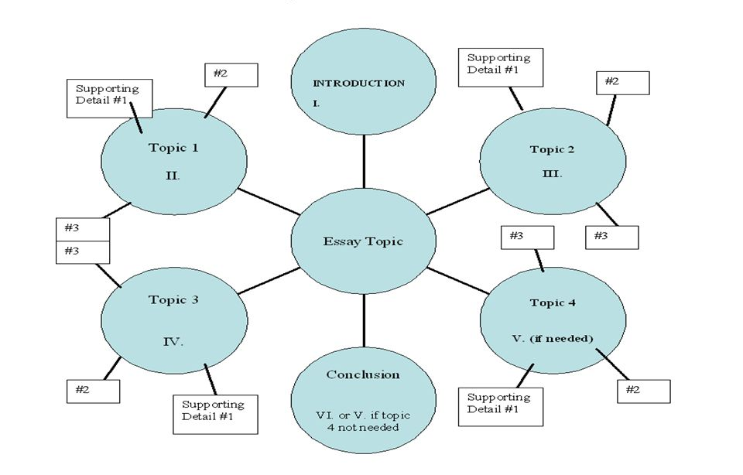
Formats

