Slide 1
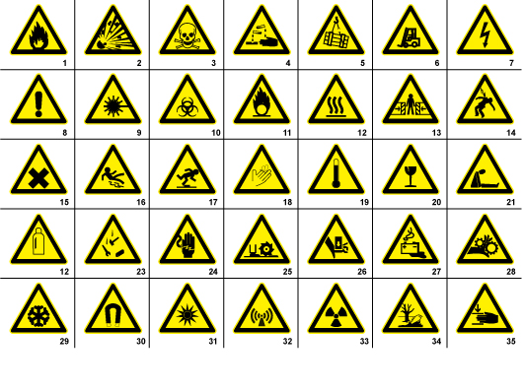
1. Flammable materials sign or symbol 2. Explosion risk sign or symbol 3. Toxic sign or symbol 4. Corrosive sign or symbol 5. Overhead crane sign or symbol 6. Fork lift in operation sign or symbol 7. High voltage sign 8. General warning sign or symbol 9. Laser radiation sign or symbol 10. Biohazard sign or symbol 11. Oxidizing sign or symbol 12. Hot surface sign or symbol 13. Entrapment risk sign or symbol 14. Electrocution risk sign or symbol 15. Irritant sign or symbol 16. Slippery floor sign or symbol 17. Watch your step sign or symbol 18. Cutting risk sign or symbol 19. High temperature sign or symbol 20. Glass hazard sign or symbols 21. Suffocation sign or symbol 22. Gas bottle sign or symbol 23. Falling objects sign or symbol 24. Electricity sign or symbol 25. Cutter sign or symbol 26. Hand hazard sign or symbol 27. Battery hazard sign or symbol 28. Rotating parts sign or symbol 29. Low temperature sign or symbol 30. Magnetic field sign or symbol 31. Optical radiation sign or symbol 32. Non ionizing radiation sign or symbol 33. Radiation sign or symbol 34. Environmental hazard sign or symbol 35. Crushing hazard sign or symbol
Safety Symbols
http://signsanddisplays.wordpress.com/2011/01/11/35-free-warning-signs-symbols

